Slide 1
Students Listening Prediction in class using Python-Django web frame work.
Let’s have a deeper look into it…..

Slide 2
Project Phase-I
Team Members:
1. Archana.A-112621104001(CSE)
2. Keerthana.B-112621104011(CSE)
3.Venmathi.R-112621104024(CSE)
Project Guide: Ms. Soumya
Assistant Professor/ DEPT: Cyber

Slide 3
Purpose of the project:
To precisely predict the student engagement in class with the help of Django based web application incorporated with machine learning algorithms and deep learning techniques.
To provide real-time feedback to educators about student engagement, allowing them to adjust their teaching strategies on the fly.
The goal is to enhance the learning experience and improve educational outcomes by fostering a more engaging classroom environment.

Slide 4
ABSTRACT
The present study investigates the prediction of academic achievement (high vs. low)machine learning and flask framework. Student’s performance is a success factor in higher education institutions. The excellent record of academic achievements raises the institution’s ranking as one of the criteria for a high-quality university. The main reason behind this is the lack of research on exploring different prediction methods and key attributes that influence the student’s academic performance. This systematic review intends to explore the current machine learning methods and attributes used in predicting the student’s performance. Measuring Student’s performance is necessary for the mordent society. Applications of Machine learning algorithms increased the growth in various fields like disease prediction ,student’s performance prediction, and crop productions prediction and in various other fields. The main aim of this study is to improve the prediction of students’ performance using various machine learning algorithms. And apply this model file in web application and it will predict the students performance.

Slide 5
Tech Stack:
1. Back-End: Django: A high-level Python web framework that encourages rapid development and clean, pragmatic design. It handles the server-side logic, routing, and database interactions.
2. Front-End: HTML,CSS & JavaScript.
3.Database: PostgreSQL
4.Machine Learning: Pandas, Numpy, Scikit-learn, TensorFlow and Keras
5. Web Server: Gunicorn : A Python WSGI HTTP server for UNIX, often used to serve Django applications.

Slide 6
Literature Survey
“Stress and Anxiety Detection Using Facial Cues from Videos” – G. Giannakakis et al.
“Detection of Stress Using Image Processing and Machine Learning Techniques” – Nisha Raichur et al.
Using Learning Analytics to Predict Student Engagement in Online Learning Environments“- D. G. Siemens, et al.
Engagement Analytics: A Case Study of a Learning Management System“- J. A. D. M. de Lima, et al.
A Django-Based Learning Management System for Higher Education - A. A. A. Alshahrani, et al.
Real-Time Student Engagement Monitoring Using Machine Learning”- M. A. A. Alzahrani, et al.

Slide 7
Methodologies
Data Acquisition: Webcam streams of students during classes are captured.
Feature Extraction: Facial landmarks, gaze tracking, and micro-expressions are extracted using OpenCV and Dlib.
Deep Learning Model: A Convolutional Neural Network (CNN) trained using PyTorch identifies engagement levels.
Feedback System: The system provides alerts and reports to students and instructors in real-time.
Web Integration: The Django framework manages the user interface, reports, and instructor dashboard.

Slide 8
Existing System
Many educational institutions use Learning Management Systems (LMS) like Moodle, Canvas, or Blackboard to track student engagement through attendance, participation in discussions, and assignment submissions.
Various academic studies have developed machine learning models to predict patterns and trends in student behavior, allowing educators to intervene when students are likely to disengage.
Django-based applications that focus on specific aspects of student engagement, can provide dashboards for educators to visualize student engagement metrics and generate reports.

Slide 9
Proposed System
Machine Learning Algorithm: LSTM(Long-Short Term Memory) a type of recurrent neural network (RNN) designed to learn from sequences of data.
Database: MySQL to store student data, engagement metrics, and model predictions , ensuring data integrity and security through proper database management practices.
Frontend: HTML, CSS, and JavaScript frameworks (e.g., React or Bootstrap) for a seamless user experience which include features such as dashboards, reports, and real-time feedback mechanisms.
Backend: Django as the backend framework to handle data processing, model integration, and user management.

Slide 10
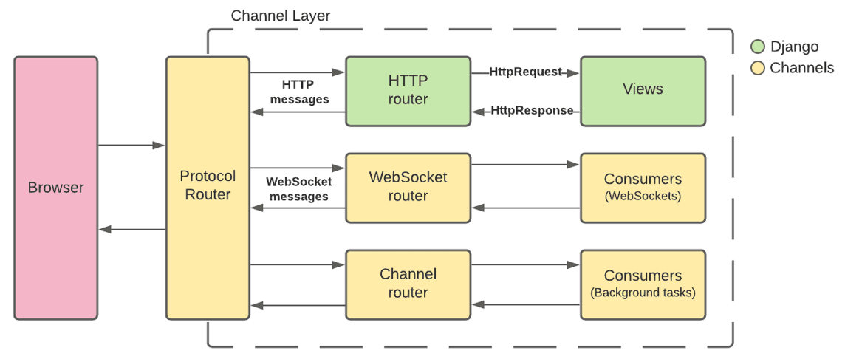
Block Diagram

Slide 11
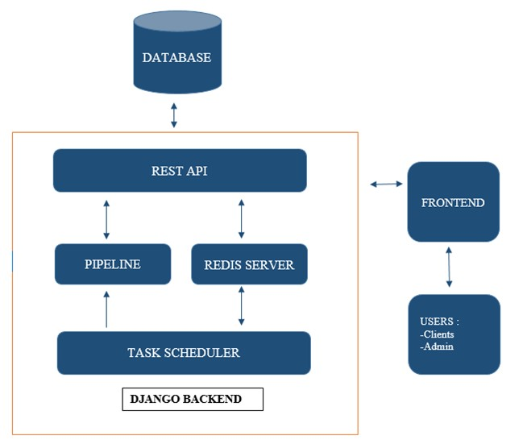
System Architecture

Slide 12
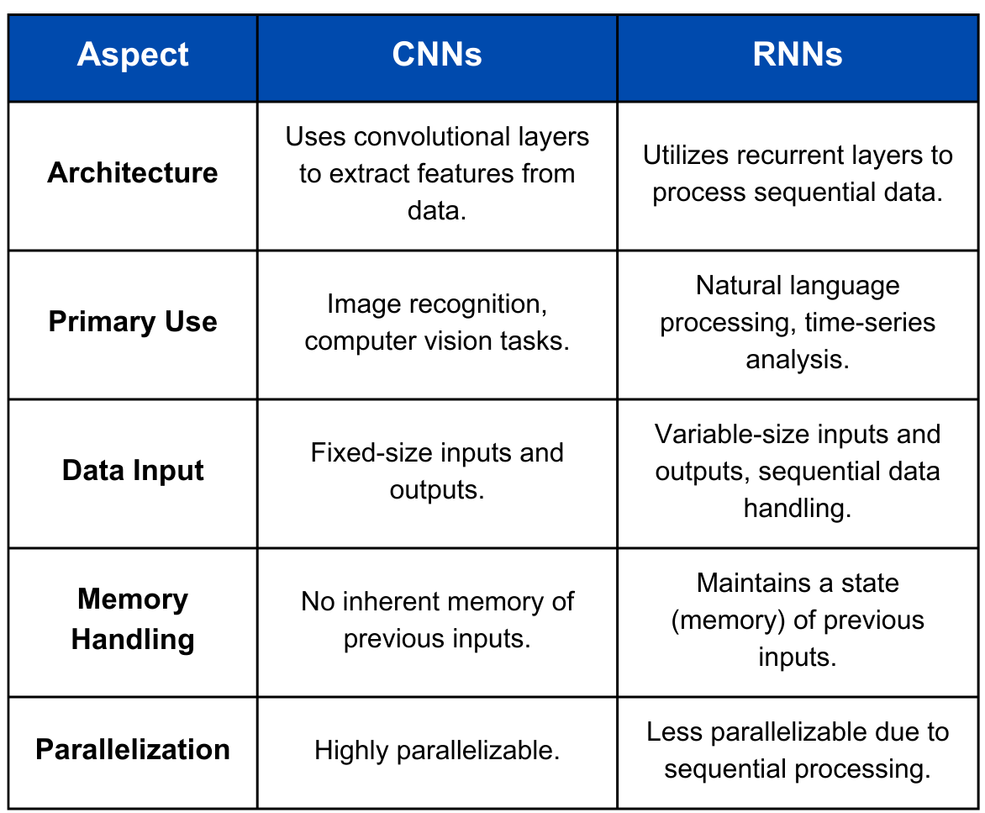

Slide 13
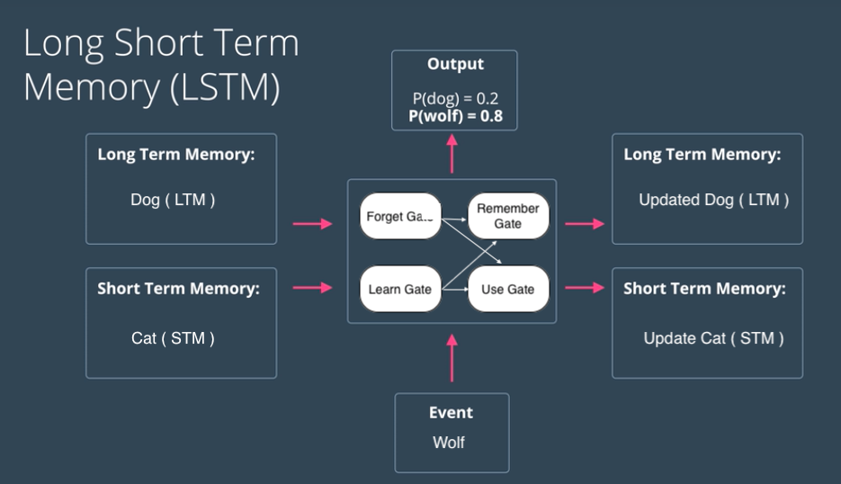
LSTM: Long – Short Term Memory
Long Short-Term Memory (LSTM) networks are a type of recurrent neural network (RNN) architecture that is particularly well-suited for sequence prediction problems. They are designed to learn from sequences of data, making them ideal for tasks such as time series forecasting, natural language processing, and, in the context of your project, predicting student engagement over time based on historical data.

Slide 14
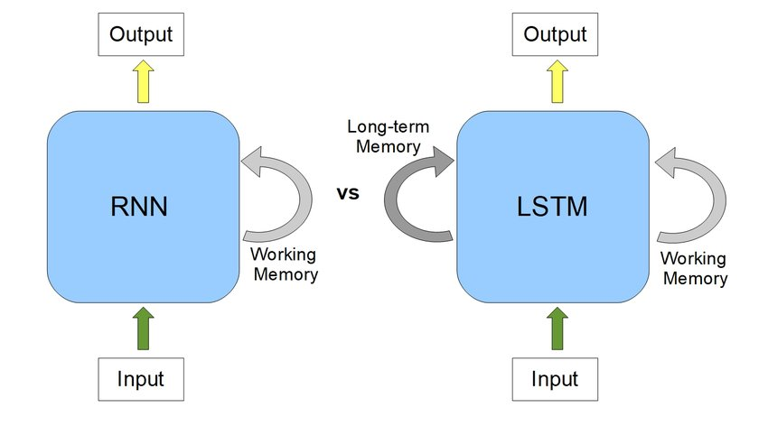
Working of LSTM:
Components of an LSTM :
Cell State (C): The cell state is the memory of the LSTM cell, which carries information across time steps. It can be thought of as a conveyor belt that runs through the entire chain of LSTM cells.
Input Gate (i): This gate controls how much of the new information from the current input should be added to the cell state. It uses a sigmoid activation function to determine which values to update.
Forget Gate (f): This gate decides what information from the cell state should be discarded. It also uses a sigmoid activation function to filter out unnecessary information.
Output Gate (o): This gate determines what part of the cell state should be output to the next layer or time step. It uses a sigmoid activation function to control the output.

Slide 15
Applications:
Real-Time Engagement Monitoring:Enables timely interventions, such as adjusting teaching methods or providing additional support to students who may be struggling.
Data-Driven Decision Making:Data-driven approaches can enhance the effectiveness of teaching and improve overall educational outcomes.
Enhanced Teacher-Student Interaction:Improved interaction can create a more supportive and engaging learning environment, leading to higher student motivation and involvement.
Integration with Learning Management Systems (LMS): This integration can provide a more comprehensive view of student engagement and performance, enriching the educational experience.
Feedback and Assessment Tools:Continuous feedback allows teachers to refine their approaches and assess the impact of changes in real-time, leading to ongoing improvement in teaching practices.

Slide 16
References
A Machine Learning Approach to Predicting Student Engagement in Online Learning-Alharbi, A. M., et al. (2020). A Machine Learning Approach to Predicting Student Engagement in Online Learning. IEEE Access, 8, 123456-123467.
Engagement Analytics: A Case Study of a Learning Management System-de Lima, J. A. D. M., et al. (2018). Engagement Analytics: A Case Study of a Learning Management System. Journal of Computing in Higher Education, 30(2), 1-20.
A Django-Based Learning Management System for Higher Education-Alshahrani, A. A. A., et al. (2021). A Django-Based Learning Management System for Higher Education. International Journal of Emerging Technologies in Learning, 16(5), 4-15.
Using Learning Analytics to Predict Student Engagement in Online Learning Environments-Siemens, G., et al. (2013). Using Learning Analytics to Predict Student Engagement in Online Learning Environments. Journal of Educational Technology & Society, 16(2), 1-12.

Slide 17
THANK YOU!!

